Slide 1
QXU4004 Engineering Chemistry
Dr Sulafudin Vukusic
s.vukusic@qmul.ac.uk

Slide 2
Suggested Reading List:
Chapters 5 and 6: “Organic Chemistry” by Francis A. Carey & Robert M. Giuliano (10th Edition, McGraw-Hill Education, 2017).

Slide 3
QXU4004 Engineering Chemistry
Alcohols醇, Alkyl halides卤代烃 and nucleophilic substitutio亲核取代

Slide 4
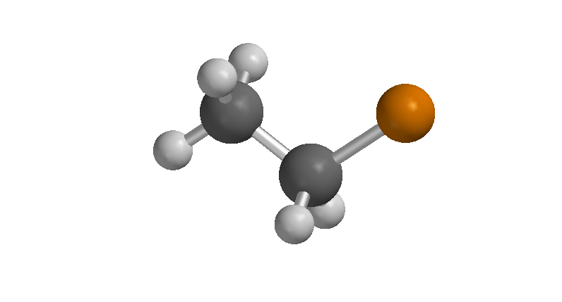
Alkyl Halides

Slide 5
Examples of alkyl halides

Slide 6

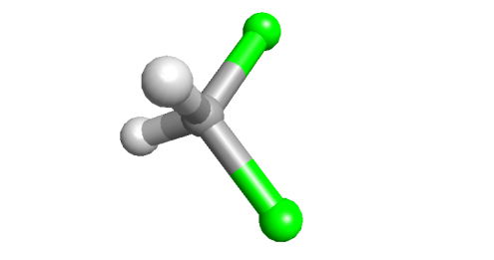
Nomenclature and properties （命名和性质）
Choose the longest chain
Number from the end nearer the first substituent (X or R)
Prefix in alphabetical (not positional) order
Alkyl halide（卤代烷） physical properties are very much like the alkanes; they are hydrophobic volatile liquids, although a little more polar than alkanes
Dichloromethane (CH₂Cl₂) is a common solvent（溶剂）

Slide 7
Alkyl halide preparations

Slide 8
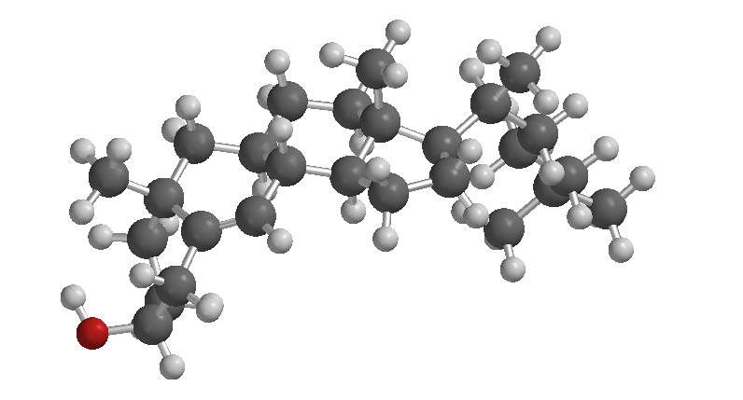
Alcohols

Slide 9
Examples of alcohols

Slide 10
Nomenclature and properties
Choose the longest chain containing the OH group
Number from the end nearer to the OH group
The compound is named as an –ol
Hydrogen bonding makes the alcohols hydrophilic, polar and (relatively) high boiling
Selected bp (ºC) shown
C₂H₆ ethane | -89.0
C₂H₄ ethene | -102.7
CH₃CH₂Cl | 12.5
CH₃CH₂OH | 78.3

Slide 11
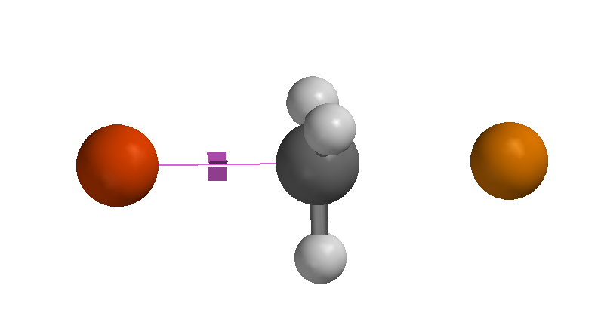
Reaction mechanism and energetics
Few organic reactions are ‘one-step’
But, reaction of bromo-methane with iodide is
At one point the C-Br bond is ‘part-broken’, and the I-C bond is ‘part-formed’

Slide 12
Substitution reaction mechanisms
This is a reaction mechanism (we use curly arrows in reaction mechanisms)
Progress of reaction showing the simultaneous formation of C-I bond and breaking of the C-Br bond, the transition state is the highest energy point in this process with bonds partially formed/broken
This is NOT what we call a reaction mechanism (we don’t normally use transition states when drawing reaction mechanisms)
Few organic reactions are ‘one-step’
But, reaction of bromo-methane with iodide is
At one point the C-Br bond is ‘part-broken’, and the I-C bond is ‘part-formed’

Slide 13
Reaction energy profile
The ‘structure’ with the part-broken C-Br and part-formed I-C is the highest point on the energy pathway, the transition state
ALL reactions pass through a transition state per step of the reaction

Slide 14
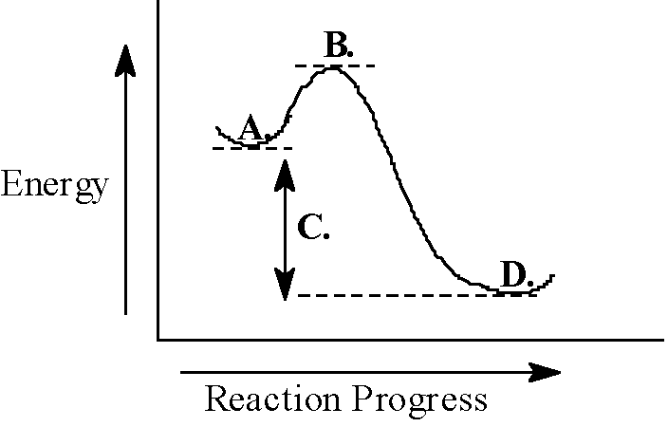
General reaction energy profile
A = reactants
B = Transition state
C = reaction free energy (ΔG)
D = products
The ΔE(B-A) is called the activation energy
Note: This is for a single-step reaction, or a single step of a multi-step reaction

Slide 15
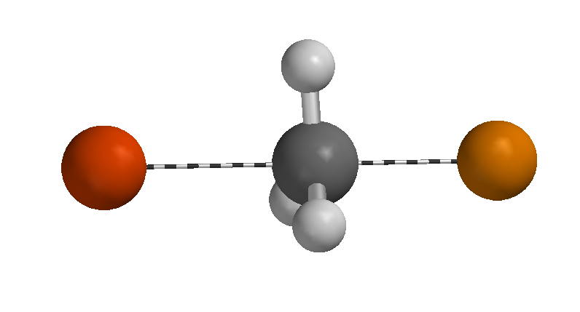
Mechanism: nucleophilic substitution
As the new bond forms and the old one breaks, the reaction energy rises towards the TS
In the TS the Y---C bond is part-formed, the C---X bond is part-broken; Y and X each have δ-

Slide 16
These are NOT reaction mechanism (just explanations)
This reaction is a type of “nucleophilic substitution” (we look at what the carbon reacts with, in this case the carbon acts as an electrophile, therefore, reacts with a nucleophile
The reaction is a substitution (one group is substituted by another) (other type of reactions are additions or eliminations, in which groups are added to the carbon or taken away)
We call it SN2: S-substitution, N-nucleophilic（亲核的）, 2: 2nd order kinetics (just think about it, it is a single-step reaction and two species react)
This is the reaction mechanism
The number 2 refers to the overall order (kinetics) and NOT the number of steps (SN2: 1 step)

Slide 17
Nucleophilic substitution（取代反应）
These are NOT reaction mechanism (just explanations)
This is the reaction mechanism
The halogen (X) can be displaced (substituted) by a nucleophile (Y)
The C in C-X is polarised δ+, so is attractive to a nucleophile (a nucleophile (Y above) is an atom of group with a lone pair; it may or may not have a (-) charge)
Enticed by the δ+, the nucleophile uses its lone pair to form a new bond to C; the existing bond to X ‘leaves’ taking the two electrons onto X as a lone pair
Remember, when a nucleophile uses a lone pair to form a bond, it gains a (+)

Slide 18
Mechanism and kinetics: S_{N}2
Experimentally, the rate of this reaction is found to depend on both [Y⁻] and [R-X]
It occurs when Y and RX collide with correct orientation and energy
This mechanism is termed Substitution Nucleophilic 2 (bimolecular) i.e. S_{N}2 (“2” refers to the kinetics, NOT the number of “steps”)

Slide 19
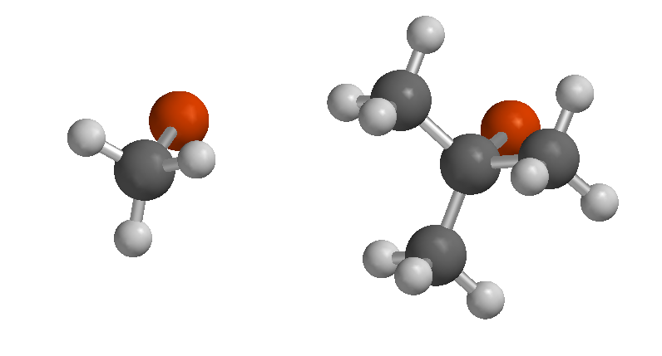
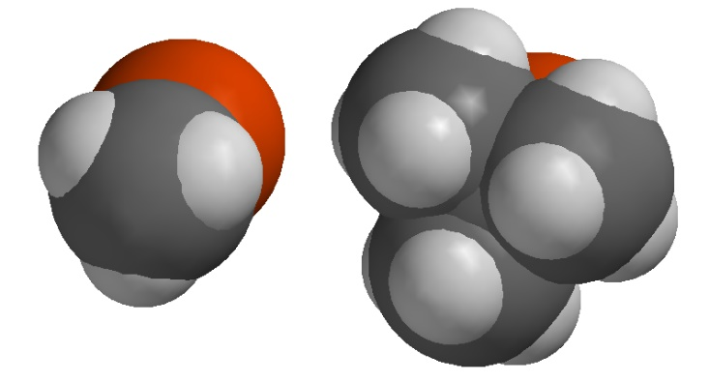
S_{N}2 mechanism: steric factors（空间因素）
Steric: relating to the spatial（空间的） arrangement and size of atoms and groups in a molecule, especially as it affects chemical reactions. (steric factors/effects affect reactions where a reactant may find difficult to approach the reactive site of the molecule because of the size of the groups attached to it)
Go right,R groups take space,no space for Y
In order to ‘push out’ the –X^{δ-}, Y⁻ must approach from ‘the rear’/’the back’, coming in past the other groups on C
So as these get larger the reaction becomes slower (more difficult) (
in the example here, methyl-X reacts the fastest and tertiary-X the slowest (or not at all)

Slide 20
An alternative S_{N} mechanism
Chloromethane undergoes S_{N}2 with iodide as shown; the reaction is complete in minutes
Under similar condition 2-chloro-2-methylpropane (tert-butyl chloride) shows no reaction
BUT, if the conditions are altered, it reacts immediately
although now CH₃Cl doesn’t

Slide 21
The S_{N} 1 mechanism
This is clearly S_{N} (nucleophile is H₂O), but not the same mechanism as for S_{N}2
The conditions give a clue to the mechanism
Also, experimentally, the rate of this reaction is found to depend on ONLY [R-X]
This mechanism is termed Substitution Nucleophilic 1 (unimolecular) i.e. S_{N}1 (“1” refers to the kinetics, NOT the number of “steps”)

Slide 22
This is still a “nucleophilic substitution” (we look at what the carbon reacts with, in this case the carbon acts as an electrophile, therefore, reacts with a nucleophile(亲核基团)
The reaction is a substitution (one group is substituted by another) (other type of reactions are additions or eliminations, in which groups are added to the carbon or taken away)
We call it SN1: S-substitution, N-nucleophilic, 1: 1st order kinetics (just think about it, in the rate determining step (slow step) there is only one reagent)
The number 1 refers to the overall order (kinetics) and NOT the number of steps (SN1: 2 steps)

Slide 23
The S_{N} 1 mechanism（steric factor does not work）
The X departs as X⁻ in 1st step to leave behind a carbenium ion also (also called carbocation) (polar solvent favours dissociation because the carbocation is charged, therefore more stable in polar solvents)
Then in second step the nucleophile attacks carbenium ion (even a weak nucleophile can attack a C⁺)
The first step is rate-limiting (only R-X is involved in this step, so only [R-X] appears in the rate equation)

Slide 24
S_{N}1 mechanism: electronic factors（极性溶剂）
Electronic factors: relating to the spread and stabilization of charges/partial charges or charge density in a molecule, especially as it affects chemical reactions. (electronic factors/effects affect reactions where charge/partial charge spread gets more stabilised OR destabilised due to the groups attached to the reactive sites)
The key (rate-limiting) step involves formation of a carbenium ion (or carbocation)
So reactivity parallels ease of formation (stability) of carbenum ion
This is opposite trend to S_{N}2

Slide 25
Carbenium ion/carbocation stability
The order of alkyl carbenium ion stability (i.e. ease of formation) is as shown
Remember (from earlier) that resonance-delocalised carbenium ions are also stabilised
If these are included, the order is as shown

Slide 26
S_{N}2 or S_{N}1 mechanism?(对比)
Mechanism | S_{N}2 favoured | S_{N}1 favoured
Structure of R in R-X | methyl, 1º, (2º) | 3º, (2º)
Solvent | varies | polar
Nucleophile (Y:) | strong | moderate - weak
Leaving group (-X) | moderate | good
Structure R: steric factor SN2, electronic factor SN1
Solvent: affects SN2 less, affects SN1 a lot
Nucleophile “strength”: nucl. only affects SN2 kinetics
Good leaving group: needs to be relatively good for both, but affects SN1 more
R-X | Mechanism
methyl, 1º | S_{N}2 only
2º | S_{N}2 or S_{N}1 (both slow)
3º | S_{N}1 only
1º allyl or benzylic | S_{N}2 or S_{N}1 (both fast)
vinyl or aryl (X directly attached to π carbon) | No S_{N}

Slide 28
k (kinetic constant for all these reactions)
The addition of 5 (SN2: 5+log k) is simply to be able to have both type k in the same graph, you can ignore it

Slide 29
k_{SN1}/k_{SN2}

Slide 30
Reactions: S_{N} OH leaving group
The C-OH bond is polarized, (ΔEN_{C,O} ~ 1.0), so the OH is a potential leaving group
But, OH is a very poor leaving group (as the anion ⁻OH).
Pre-protonation (in acid) enhances the polarisation (see next slide) and converts it to a good -OH₂⁺ leaving group
The -OH₂⁺ is a good leaving group because it leaves as the very stable neutral H₂O (water) molecule.
This is an S_{N}2 reaction
Question? Will very much of the alcohol be ‘protonated’, even in strong acid, i.e is it a strong base?
Answer. NO, so this only works with good nucleophiles

Slide 31
Reactions: OH leaving group
With the enhanced polarisation and better leaving group, a good nucleophile such as Br⁻ can react, despite the small proportion of alcohol that is protonated
But, weaker ones, e.g. Cl⁻ cannot
The solution is to use a Lewis Acid which also enhances polarisation
But now ALL the alcohol is in the complexed reactive form

Slide 32
Reactions: S_{N}2 OH leaving group
Alternatively, the poor leaving group –OH can be converted to a better one, e.g. –O-P(=O)Cl₂
As with –OH₂⁺ and –O-ZnCl₂, the –O-P(=O)Cl₂ groups enhances the δ+ at C
But, also the P=O bond is very strong, so the desire to turn C-O-P into O=P makes it a good leaving group
Under acidic conditions, 3º alcohols undergo S_{N}1

Slide 33
Alcohol as a nucleophile（亲核试剂）
Remember the H₃N and BH₃ reaction involving a filled orbital (lone pair) (nucleophile) and an empty one (electrophile)?
The lone pair on the O makes it a weak-moderate nucleophile.
A common and very reactive electrophile (empty orbital) is the carbenium ion intermediate
So the O uses its lone pair (filled orbital) to overlap with an 'empty' orbital of the carbenium ion; O becomes (+) and C(+) becomes neutral
The lone pair can be regained, and the (+) lost by expulsion of H⁺ (keeping the two electrons!)

Slide 34
Alcohol as a base
判断酸碱性：共轭酸碱强，碱酸就弱
A specific E⁺ is H⁺, so, R-OH can use a lone pair to donate to H⁺; thus it can be a base
The reverse regains the lone pair by expulsion of the H⁺
Either the ‘new’ or the ‘old’ H can be lost
‘Basicity’ is quantified by the ‘acidity’ of the conjugate acid
Alcohol is a weak base and is only appreciably protonated in strong acid (e.g. conc H₂SO₄)
Large K_{a} and low (-) pK_{a} means strong conjugate acid
Strong conjugate acid means weak base

Slide 35
Alcohol as an acid
Seesaw concept to judge the strength of acid or base
The O-H bond can dissociate to R-O⁻ and H⁺, so RO-H is a proton donor, an acid
‘Acidity’ is quantified by pK_{a}
Alcohols are very weak acids; equilibrium lies well to the ‘left’
BUT, a metal such as Na will turn H⁺ into H₂, which is lost
So, equilibrium is shifted to alkoxide
Alkoxide is a strong base
Small K_{a} and high (+) pK_{a} means weak acid
Weak acid means strong conjugate base

